Slide 1

Bio Inspired Algorithm: based on Novelty Search for Multimodal Optimization
Takuya Iwase
Informatics Department
The University of Electro-Communications

Slide 2
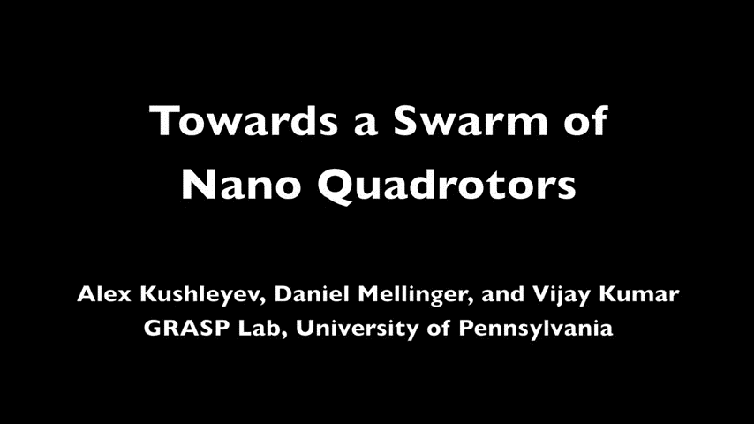
Swarm of Drones

Slide 3
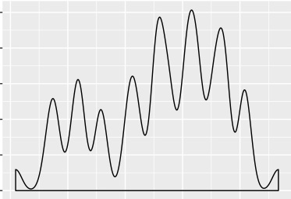
Introduction
Multimodal Optimization
local minima
global minimum
Notes:
Multimodal optimization aims to find solutions which reached low-fitness peaks on the benchmark function. For this problem…

Slide 4
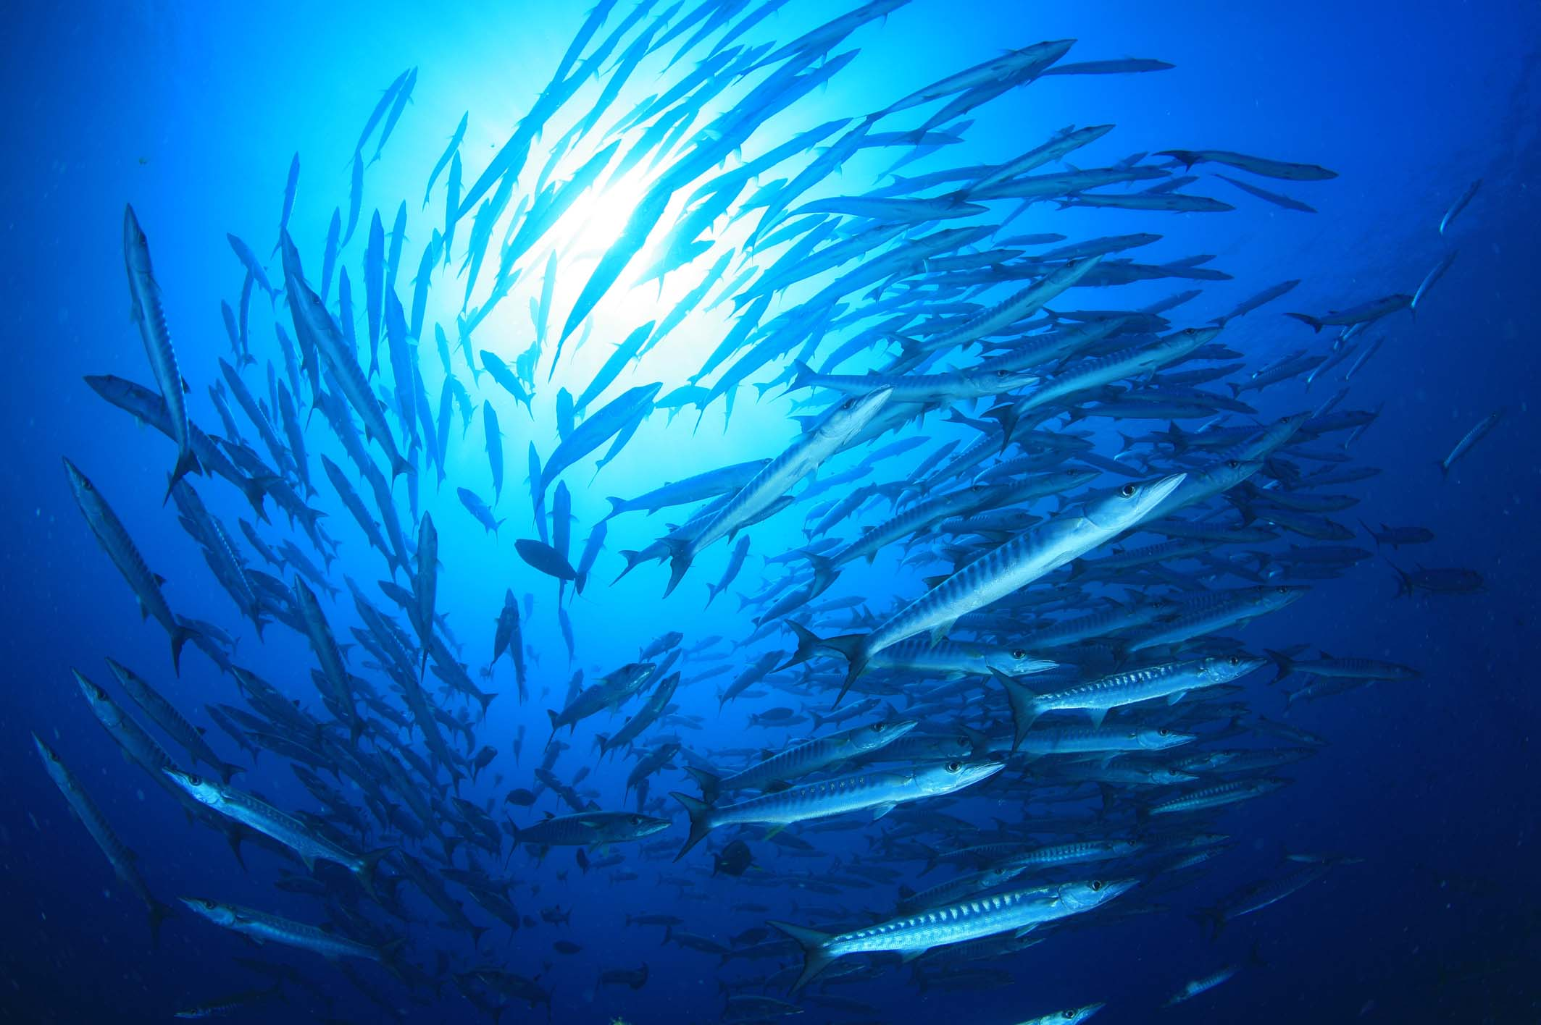
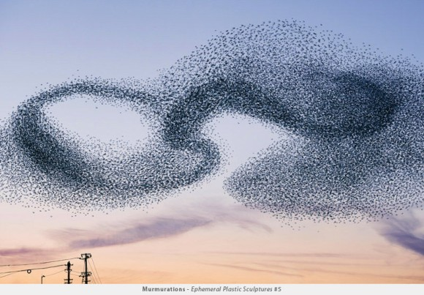
Bio Inspired Algorithms
Algorithmically depict bio behavior (ex. Fishes, Birds) = Bio Inspired Algorithms
Notes:
Bio-inspired algorithms are often used. These algorithms are based on biological evolution in nature-inspired system (like fishes, birds, and so on). In these algorithms,

Slide 5
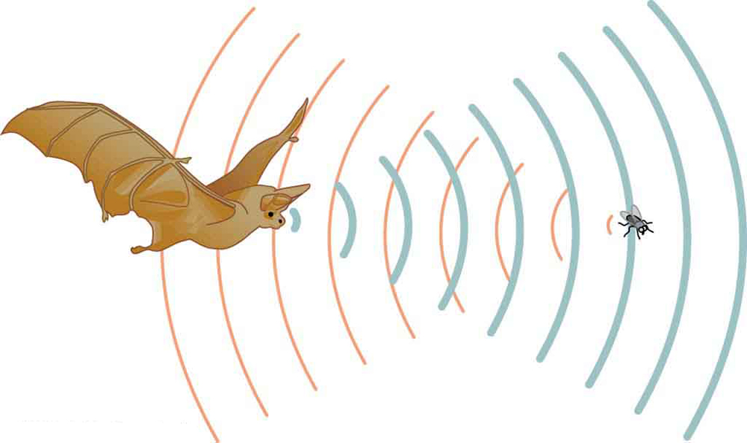
Bat Algorithm
Bat behavior
Parse rate
Loudness
Echolocation: characteristic of bats for finding prey and food
= adjusting the balance between global and local search
Notes:
Bat algorithm is able to switch the performance of global and local search automatically with echolocation. Echolocation is characteristic of bats for finding prey and food. Echolocation consists of loudness, parse rate and frequency. As bat moves toward target, echolocation is gradually adjusted in proportion to travel distance of bat.

Slide 6
BA vs distributed BA
: bat
Notes:
However, the performance of global search is a bit higher than local search, bat
algorithm is easily fallen global minimum or high-fitness value on multimodal problems.
In my research(anime), I propose distributed Bat Algorithm.

Slide 7
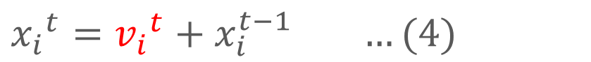
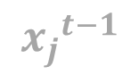
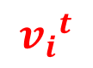
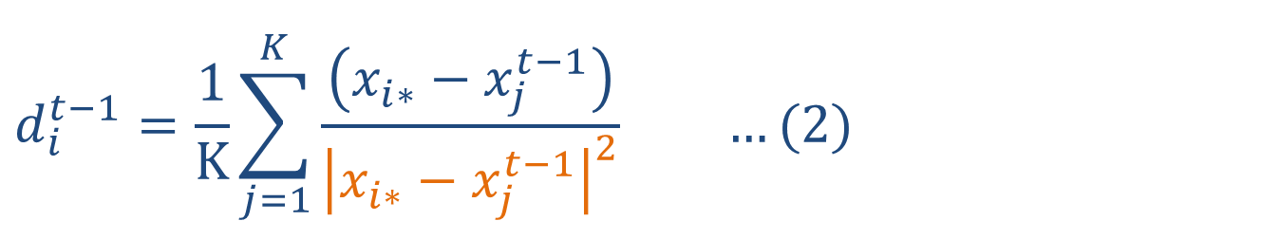
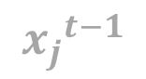
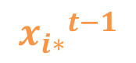
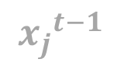
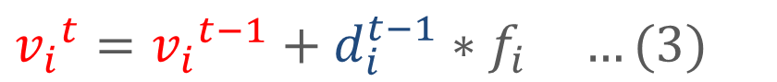
Bat Algorithm
$$d_{i}^{t−1}={{\frac{1}{K}\sum_{j=1}^{K}{\frac{\left(x_{i∗}−x_{j}^{t−1}\right)}{{\left|x_{i∗}−x_{j}^{t−1}\right|}^{2}}} …(2)}_{}}^{}$$
K=3の場合
$${x_{j}}^{t−1}$$
$${x_{j}}^{t−1}$$
$${x_{i∗}}^{t−1}$$
個体間の距離（近い>遠い）
$${v_{i}}^{t}$$
$${x_{j}}^{t−1}$$
${v_{i}}^{t}={v_{i}}^{t−1}+d_{i}^{t−1}∗f_{i} …(3)$
${x_{i}}^{t}={v_{i}}^{t}+x_{i}^{t−1} …(4)$
3

Slide 8
NSBA
K近傍 + 個体間の距離を考慮
$$d_{i}^{t−1}={{\frac{1}{K}\sum_{j=1}^{K}{\frac{\left(x_{i∗}−x_{j}^{t−1}\right)}{{\left|x_{i∗}−x_{j}^{t−1}\right|}^{2}}} …(2)}_{}}^{}$$
K=3の場合
$${x_{j}}^{t−1}$$
$${x_{j}}^{t−1}$$
$${x_{i∗}}^{t−1}$$
個体間の距離（近い>遠い）
$${v_{i}}^{t}$$
$${x_{j}}^{t−1}$$
${v_{i}}^{t}={v_{i}}^{t−1}+d_{i}^{t−1}∗f_{i} …(3)$
${x_{i}}^{t}={v_{i}}^{t}+x_{i}^{t−1} …(4)$
3

Slide 9
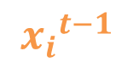
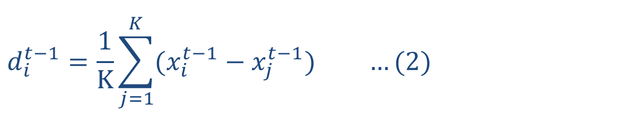
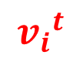

K-NNBA
K近傍数で個体の分散
$${x_{j}}^{t−1}$$
$$d_{i}^{t−1}={{\frac{1}{K}\sum_{j=1}^{K}{(x_{i}^{t−1}−x_{j}^{t−1})} …(2)}_{}}^{}$$
K=2の場合
$${x_{i}}^{t−1}$$
$${v_{i}}^{t}$$
${v_{i}}^{t}={v_{i}}^{t−1}+d_{i}^{t−1}∗f_{i} …(3)$
個体間の距離（近い<遠い）
$${x_{j}}^{t−1}$$
3

